Slide 1
Project Draft

Slide 2
Our Problem
It is difficult to find directions that effectively and efficiently guide you to your desired destination without having to stress about knowing the campus inside and out.

Slide 3
Target Audience
University of Washington students
Visitors
Faculty

Slide 4
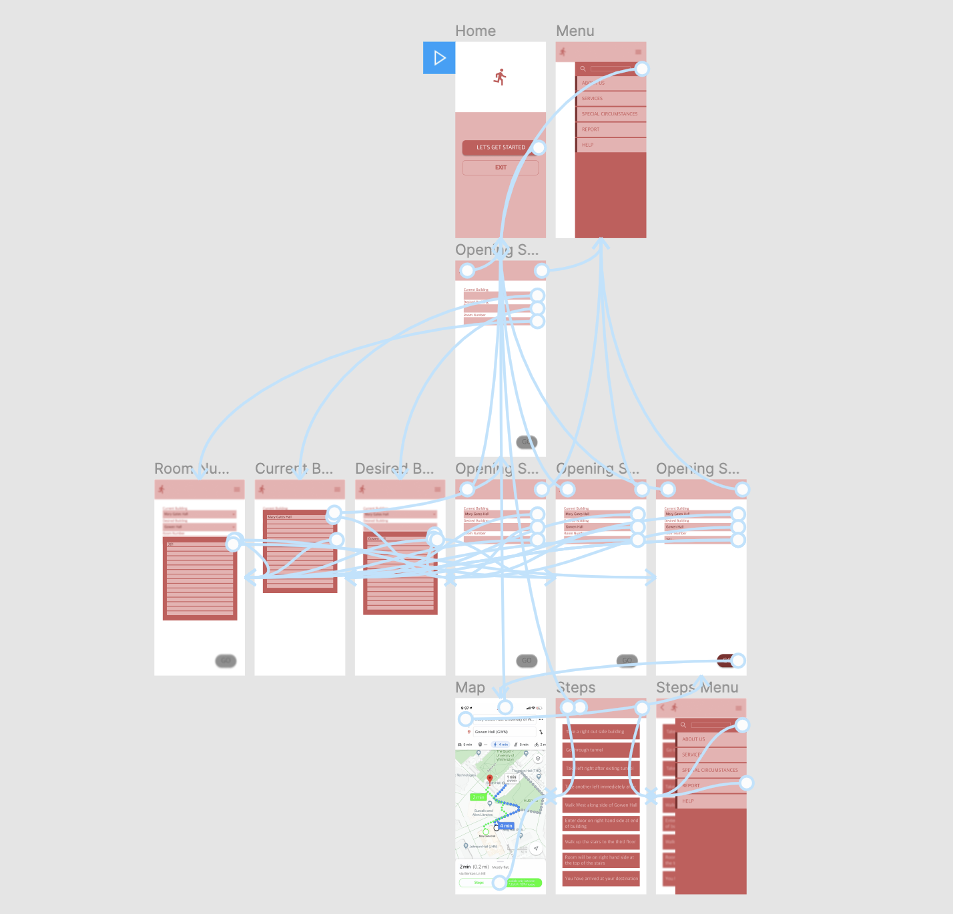
Solution
A place that localizes the abilities of popular navigation systems (Google Maps, Waze, etc.) and paves the most efficient path to your desired destination on campus.
Integrates weather as a factor as well to provide a path that reduces the chances of getting wet
It rains a LOT in Seattle

Slide 5
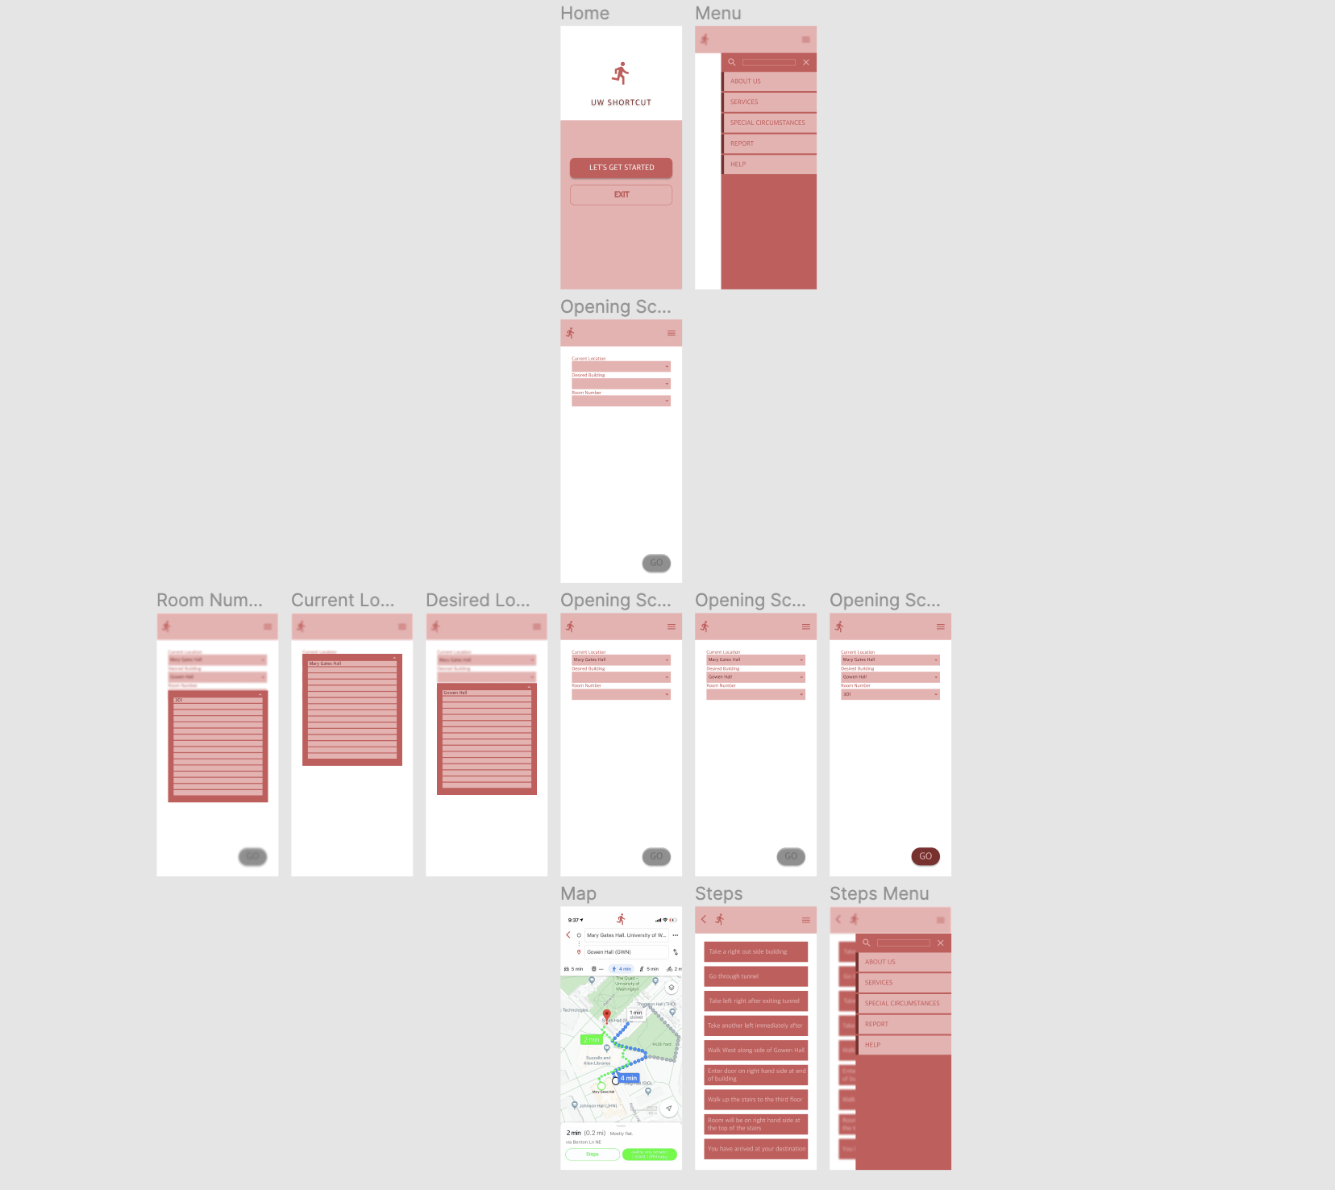
Wireframe

Slide 6
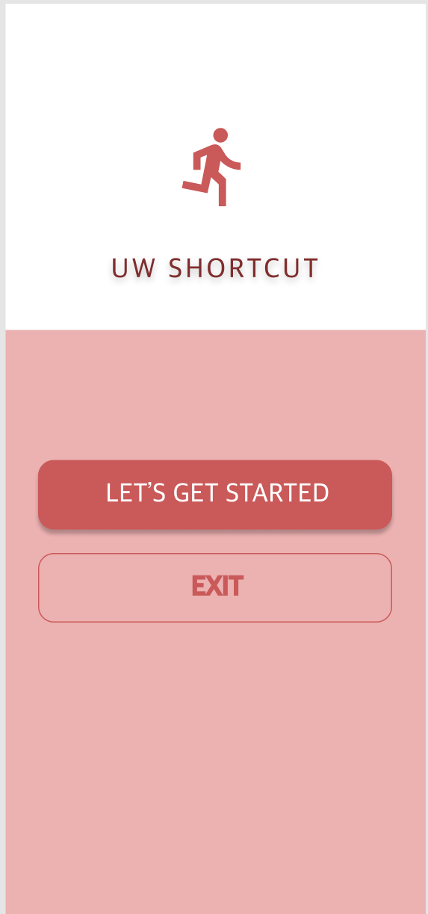
Usage Scenarios (Christian)
Christian Familiar with UW but has trouble when finding new classes
Downloads UW SHORTCUT to begin

Slide 7
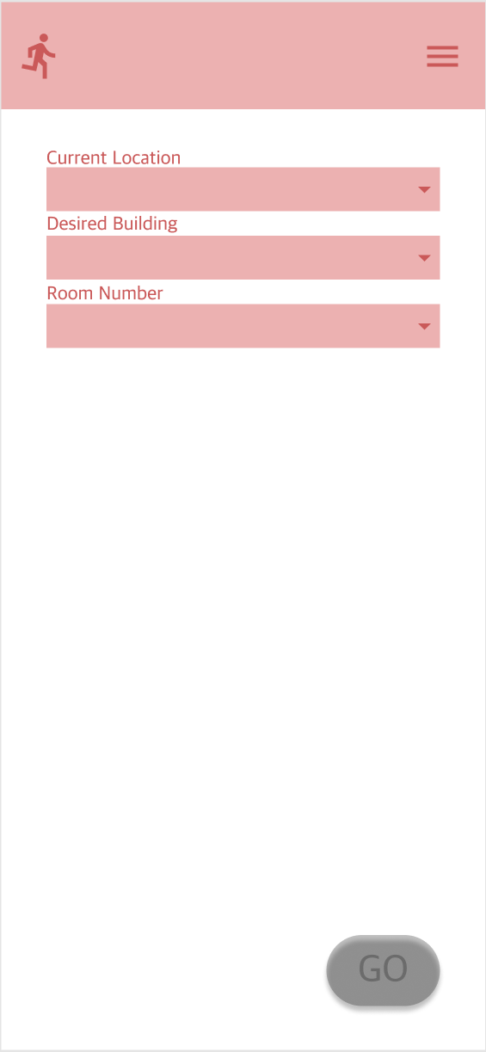
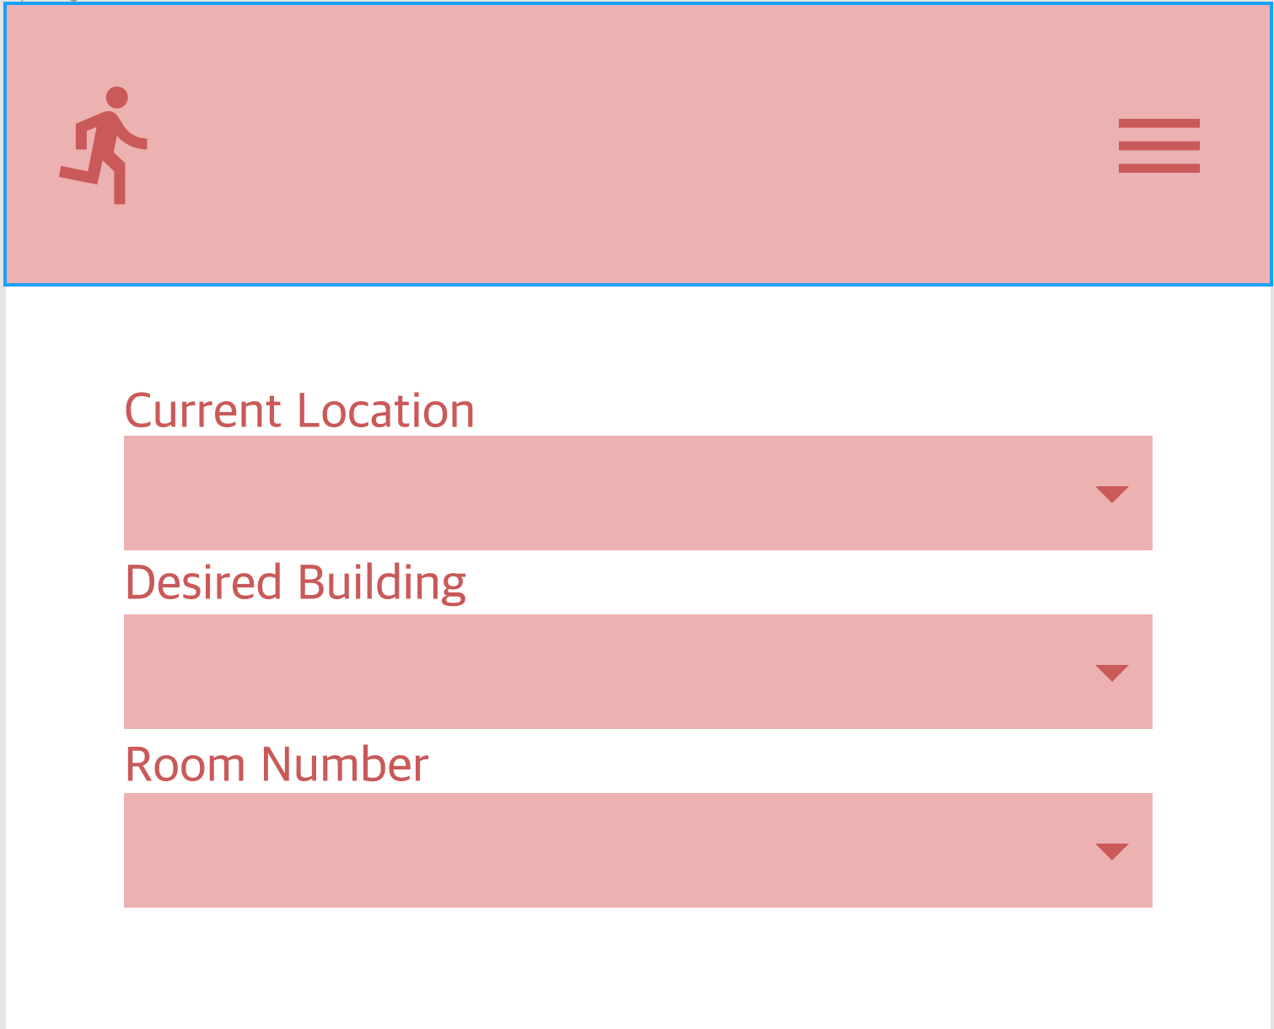
Christian needs to find Sieg Hall
Enters locations in app
Then presses GO
Lander
Sieg hall

Slide 8
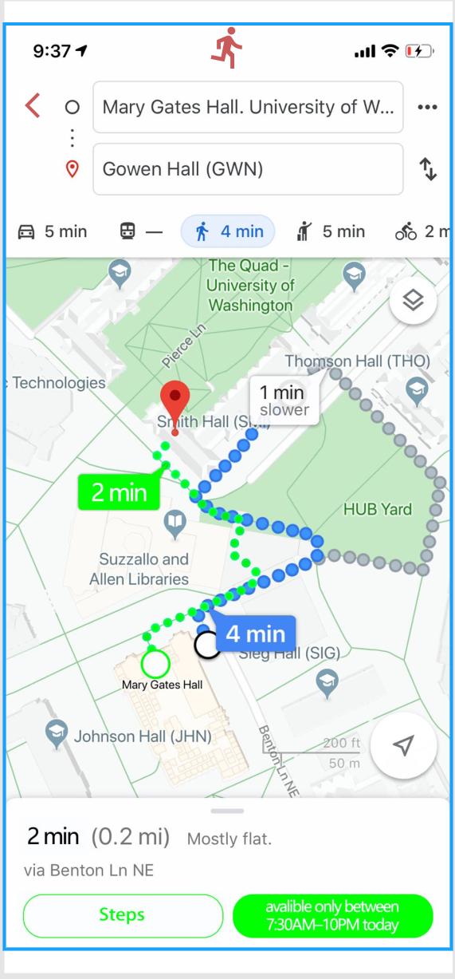
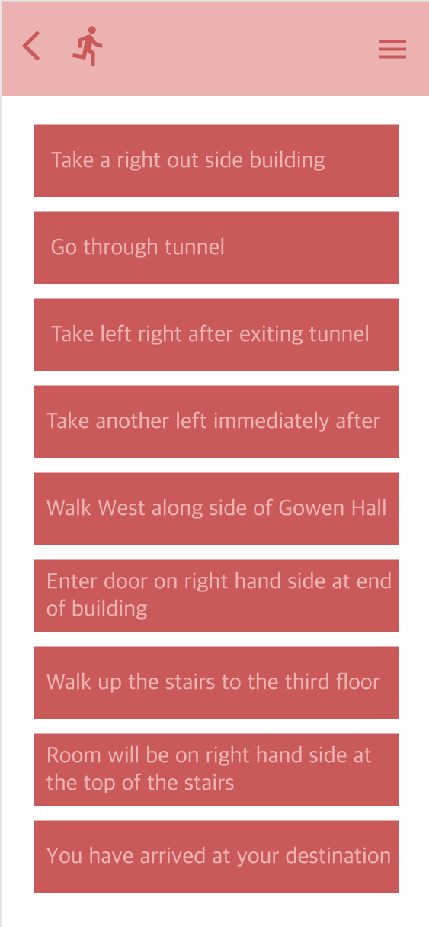
Directions are promptly shown on familiar maps layout

Slide 9
Usage Scenario (Mr. Franklin)
Mr. Franklin needs to get to Dempsey 126
An Elderly Gentleman with little knowledge of the campus

Slide 10
Enters locations in app
Memorial Way
Dempsey
126

Slide 11
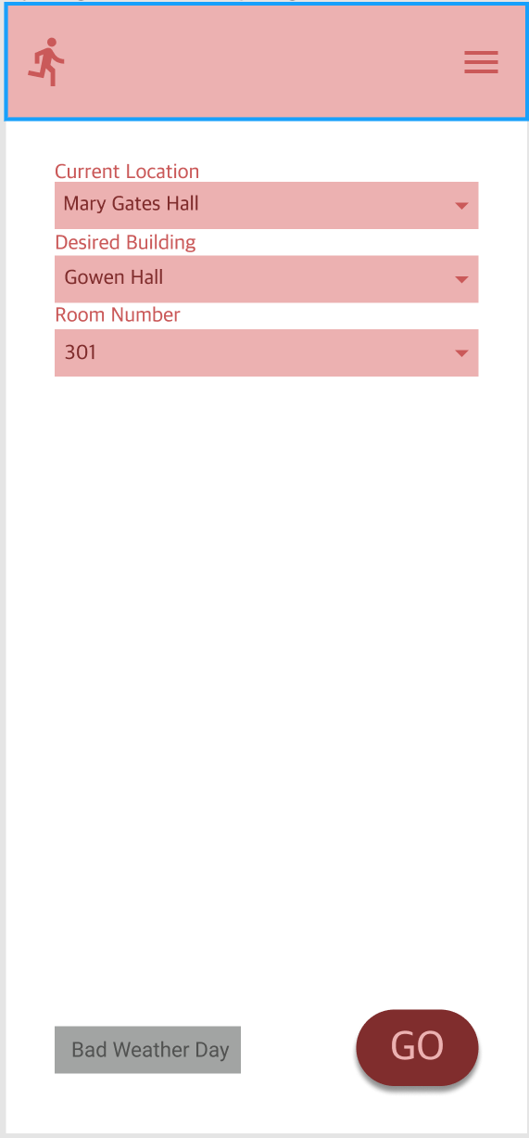
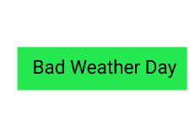
It starts to rain so he chooses the weather preferences
Then hits GO

Slide 12
Directions are promptly shown on familiar maps layout

